Slide 1

White House & GSA Open Innovation Forum Title Slide

Slide 2

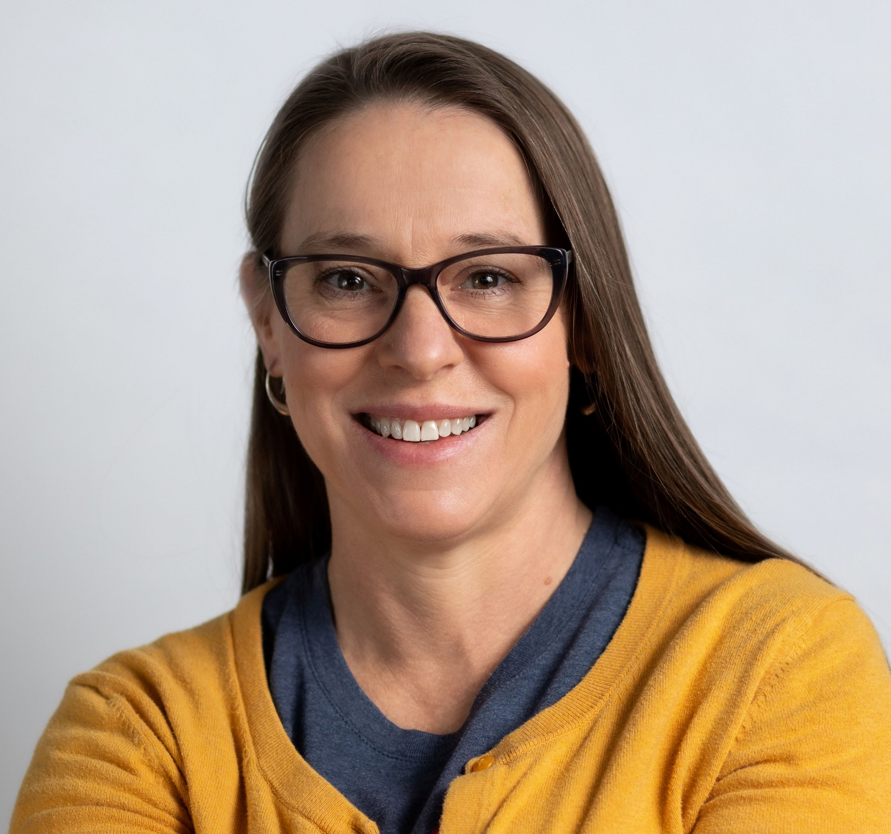
Welcome & Introductions
Dr. Jarah Meador (She/Her)
Director, Challenge.Gov and CitizenScience.Gov
General Services Administration Technology Transformation Services (GSA TTS)
Notes:
Slide uses the color palette of the Challenge.gov website; it has a white background. At the top of the page is a banner is white text against a dark blue background with small white dots.

Slide 3

Logistics
Participants will be muted during the presentation.
Use the chat for technical issues or questions.
Closed captioning is available.
Please abide by the GSA Technology Transformation Services (TTS) Code of Conduct.
Notes:
Slide uses the color palette of the Challenge.gov website; it has a dark blue background, and text in white and orange. On the right third of the card, the silhouettes of three human figures looking at laptops are in orange against a background of small white dots in a circular pattern over the dark blue. On the left, white text lies on top of dark blue background.

Slide 4
Event Agenda
Welcome & Introductions
Opening Remarks
Fireside Chat with Dr. Alondra Nelson & Administrator Robin Carnahan
Break
Biennial Report Overview
Practitioners’ Panel
Closing Remarks
Notes:
Slide uses the color palette of the Challenge.gov website; it has a dark blue background, and text in white and orange. On the right third of the card, the silhouettes of three human figures looking at laptops are in orange against a background of small white dots in a circular pattern over the dark blue. On the left, white text lies on top of dark blue background.

Slide 5

OSTP Introduction
Dr. Jedidah Isler (She/Her)
Principal Assistant Director for Science and Society
White House Office of Science and Technology Policy (OSTP)
Notes:
Slide uses the color palette of the Challenge.gov website; it has a white background. At the top of the page is a banner is white text against a dark blue background with small white dots.

Slide 6
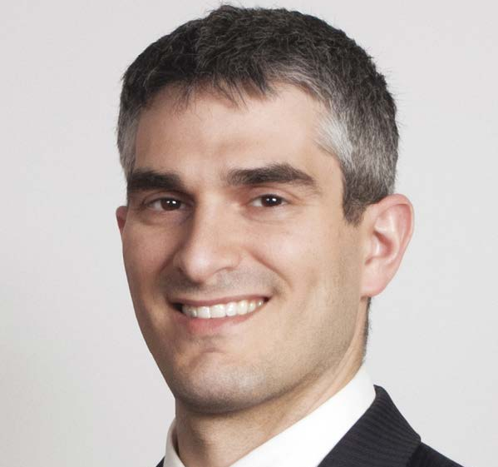
GSA TTS Introduction
Dave Zvenyach (He/Him)
Deputy Commissioner
General Services Administration (GSA)
Director
Technology Transformation Services (TTS)
Notes:
Slide uses the color palette of the Challenge.gov website; it has a white background. At the top of the page is a banner is white text against a dark blue background with small white dots.

Slide 7
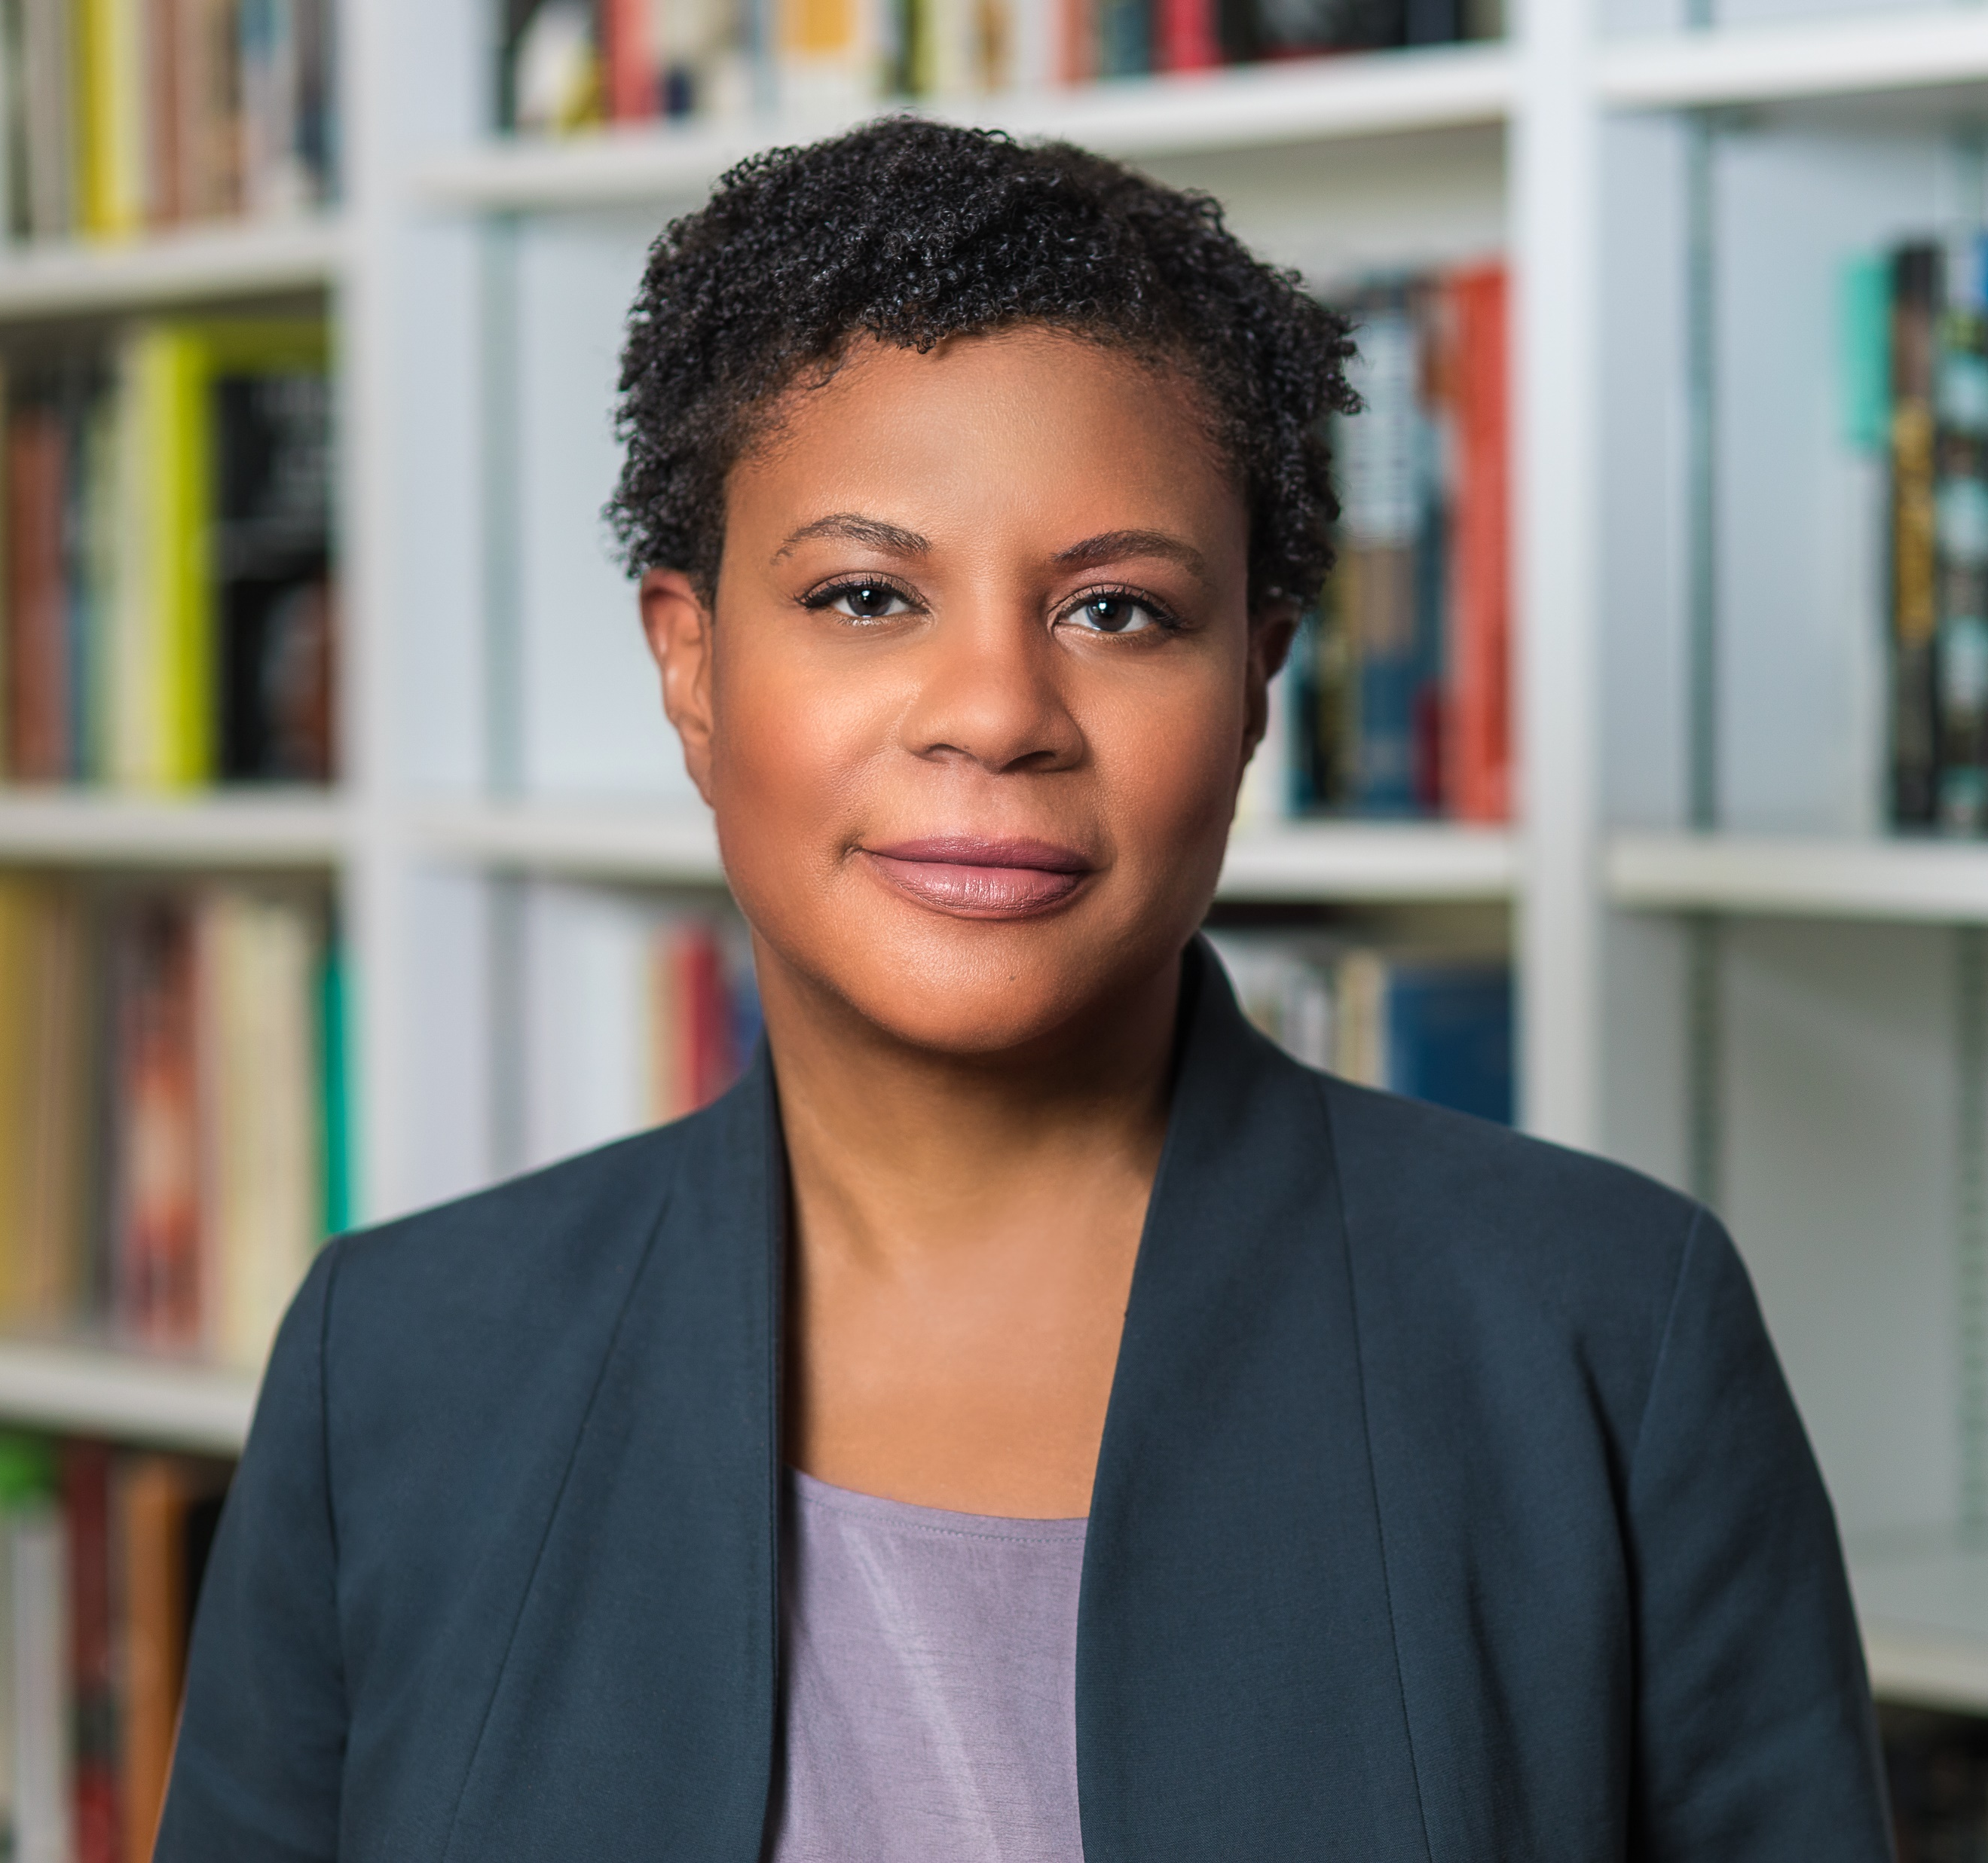
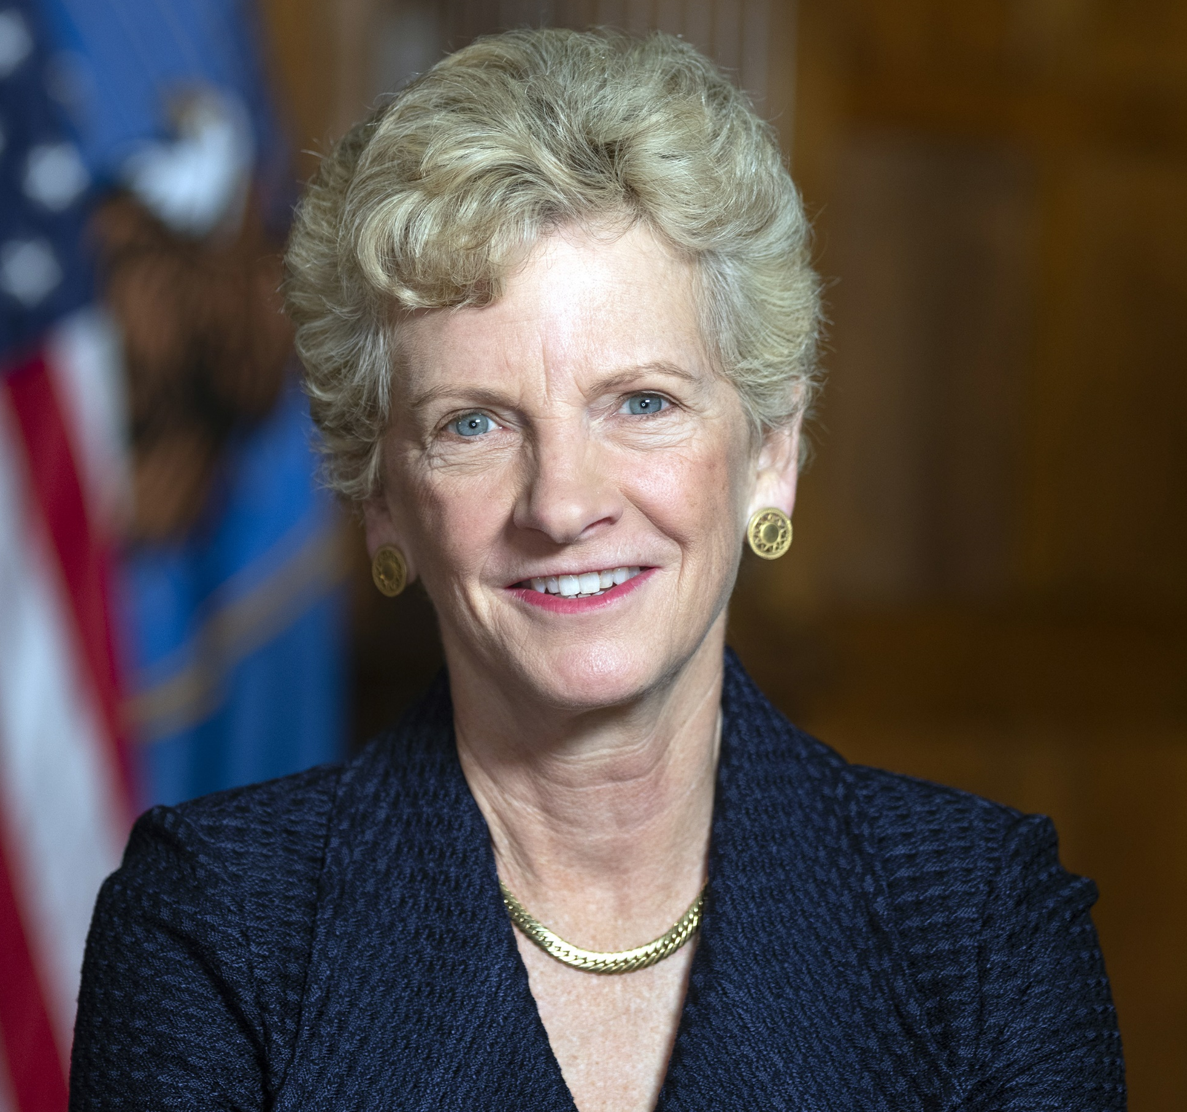
Speakers
Dr. Alondra Nelson
Deputy Assistant to the President and head of the White House Office of Science and Technology Policy (OSTP)
Robin Carnahan
Administrator of the General Services Administration (GSA)
Notes:
Slide uses the color palette of the Challenge.gov website; it has a white background. At the top of the page is a banner is white text against a dark blue background with small white dots.

Slide 8

OSTP Opening Remarks
Dr. Alondra Nelson (She/Her)
Deputy Assistant to the President and head of the White House Office of Science and Technology Policy (OSTP)
Notes:
Slide uses the color palette of the Challenge.gov website; it has a white background. At the top of the page is a banner is white text against a dark blue background with small white dots.

Slide 9

GSA Opening Remarks
Robin Carnahan (She/Her)
Administrator
General Services Administration (GSA)
Notes:
Slide uses the color palette of the Challenge.gov website; it has a white background. At the top of the page is a banner is white text against a dark blue background with small white dots.

Slide 10
Returning soon!
We are taking a short break.
Notes:
Slide uses the color palette of the Challenge.gov website; it has a dark blue background, and text in white and orange. On the right third of the card, the silhouettes of three human figures looking at laptops are in orange against a background of small white dots in a circular pattern over the dark blue. On the left, white text lies on top of dark blue background.

Slide 11
Biennial Report Overview
Dr. Jedidah Isler (She/Her)
White House Office of Science and Technology Policy (OSTP)
Implementation of Federal Prize and Citizen Science Authority for Fiscal Years 2019-2022
Notes:
Slide uses the color palette of the Challenge.gov website; it has a white background. At the top of the page is a banner is white text against a dark blue background with small white dots.

Slide 12

Practitioners’ Panel
Dr. Matt Biggerstaff, Centers for Disease Control and Prevention (CDC)
Ariel Gold, U.S. Department of Transportation (DOT)
Liam O’Fallon, National Institute of Environmental Health Sciences (NIEHS)
Hunter Jones, National Oceanic & Atmospheric Administration (NOAA)
Chaitra Shenoy, U.S. Agency for International Development (USAID)
Notes:
Slide uses the color palette of the Challenge.gov website; it has a dark blue background, and text in white and orange. On the right half of the card, the silhouettes of three human figures looking at laptops are in orange against a background of small white dots in a circular pattern over the dark blue. On the left half, dark blue text lies on top of a white background.

Slide 13
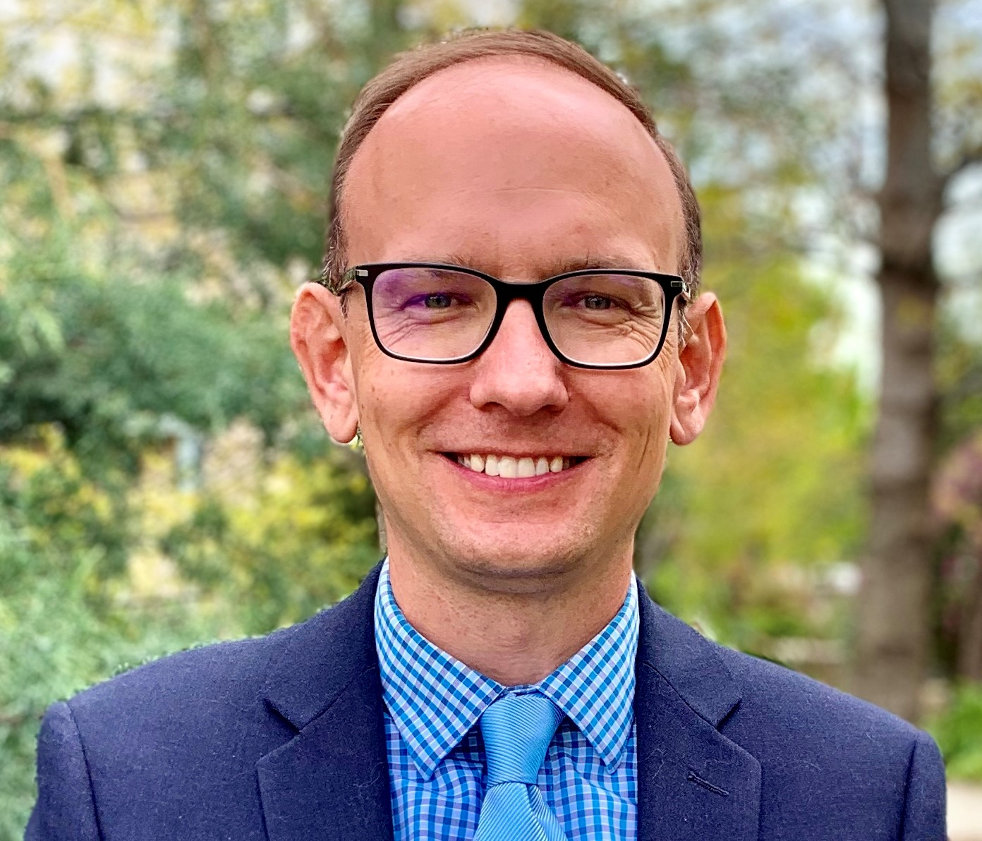
Practitioners’ Panel: CDC
Dr. Matt Biggerstaff (He/Him)
Senior Advisor for Infectious Disease Modeling and Analytics
Centers for Disease Control and Prevention (CDC)
COVID-19 Forecasting Hub
(Epidemic Prediction Initiative)
Notes:
Slide uses the color palette of the Challenge.gov website; it has a white background. At the top of the page is a banner is white text against a dark blue background with small white dots.

Slide 14
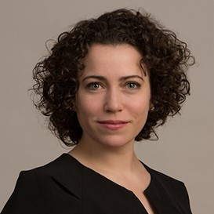
Practitioners’ Panel: DOT
Ariel Gold (She/Her)
Transportation Policy Analyst
U.S. Department of Transportation (DOT)
Inclusive Design Challenge
Notes:
Slide uses the color palette of the Challenge.gov website; it has a white background. At the top of the page is a banner is white text against a dark blue background with small white dots.

Slide 15
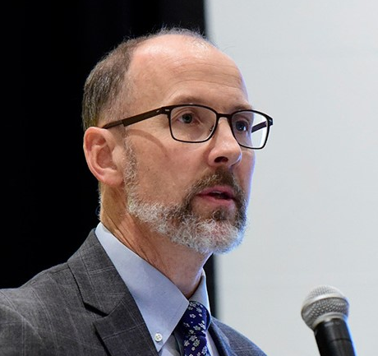
Practitioners’ Panel: NIEHS
Liam O’Fallon (He/Him)
Coordinator for the Partnerships for Environmental Public Health Program
National Institute of Environmental Health Sciences (NIEHS)
Partnerships for Environmental Public Health
Notes:
Slide uses the color palette of the Challenge.gov website; it has a white background. At the top of the page is a banner is white text against a dark blue background with small white dots.

Slide 16

Practitioners’ Panel: NOAA
Hunter Jones (He/Him)
National Integrated Heat Health Information System Program Manager
National Oceanic and Atmospheric Administration (NOAA)
Urban Heat Island Mapping Campaign
Notes:
Slide uses the color palette of the Challenge.gov website; it has a white background. At the top of the page is a banner is white text against a dark blue background with small white dots.

Slide 17

Practitioners’ Panel: USAID
Chaitra Shenoy (She/Her)
Senior Gender-Based Violence Advisor & Team Lead
U.S. Agency for International Development (USAID)
RISE Challenge
Notes:
Slide uses the color palette of the Challenge.gov website; it has a white background. At the top of the page is a banner is white text against a dark blue background with small white dots.

Slide 18
Closing Remarks
Thank you for attending today’s event.
Please complete the survey:
https://feedback.gsa.gov/jfe/form/SV_a5Aq6ZrlEWFF4eG
Stay in touch!
Federal employees: join Digital.Gov Communities of Practice
Public participants: engage at Challenge.Gov and CitizenScience.gov
Notes:
Slide uses the color palette of the Challenge.gov website; it has a dark blue background, and text in white and orange. On the right half of the card, the silhouettes of three human figures looking at laptops are in orange against a background of small white dots in a circular pattern over the dark blue. On the left half, dark blue text lies on top of a white background.

